Slide 1
Organic chemistry

Slide 2
Student objectives
Recognise homologous series of hydrocarbons: Alkanes, alkenes, alkynes, cycloalkanes, cycloalkenes
State what a functional group is and recognise functional groups of the homologous series listed above
Use general formulae to recognise members of homologous series
State what a saturated hydrocarbon is
State what an unsaturated hydrocarbon is
Write names of hydrocarbons using the IUPAC naming system for substances with up to 8 carbons in the parent chain (straight and branched alkanes and alkenes, simple only i.e. no branches cycloalkanes, cycloalkenes, alkynes)
Describe the molecular, condensed and structural formulae of hydrocarbons with up to 8 carbons in the parent chain

Slide 3
Student objectives
Use given information to predict names of hydrocarbons and infer molecular, condensed and structural formulae
Draw and identify structural isomers of hydrocarbons, including chain isomers and position isomers
Use IUPAC naming system to write names for structural isomers, using name convention for alkyl groups and numbering system for position of substituents
Define terms viscosity, volatility and flammability in relation to hydrocarbons
Describe the trends in physical properties of hydrocarbons (melting point, boiling point, viscosity, volatility, flammability)
Predict the outcome of combustion reactions of hydrocarbons (complete and incomplete)
Write and balance molecular equations for complete combustion reactions of hydrocarbons

Slide 4
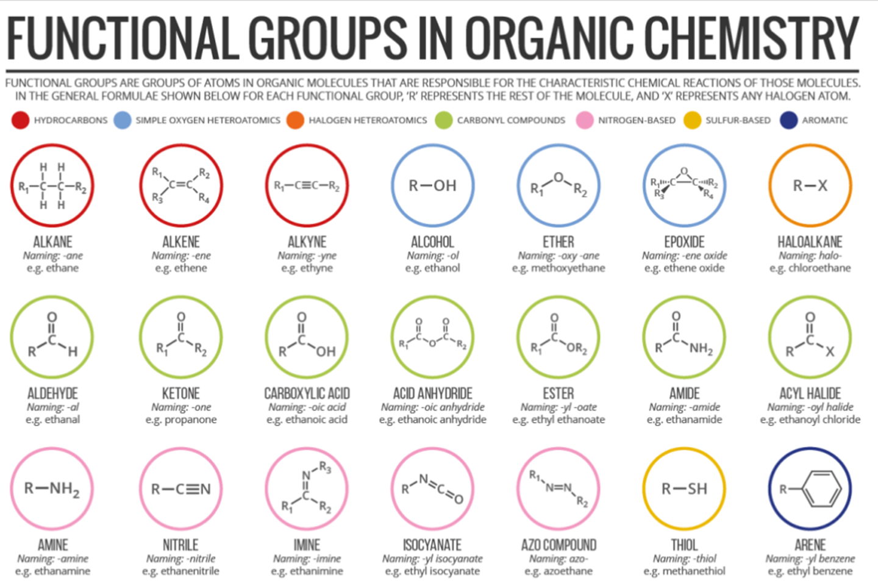
Functional groups and Homologous series
A functional group is an atom or group of atoms responsible for the typical chemical reactions of a molecule.
A homologous series is a group of molecules with the same functional group but a different number of –CH2 groups. It is a family that differs by number of carbons.
Functional groups determine the pattern of reactivity of a homologous series, whereas the carbon chain length determines physical properties such as melting/boiling points.

Slide 5
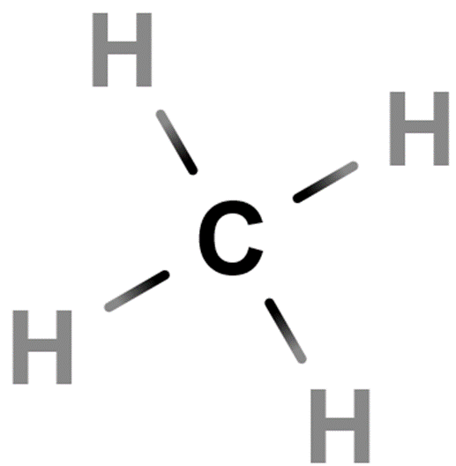
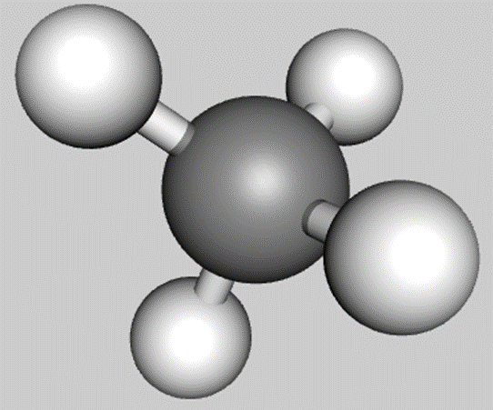
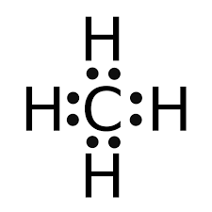
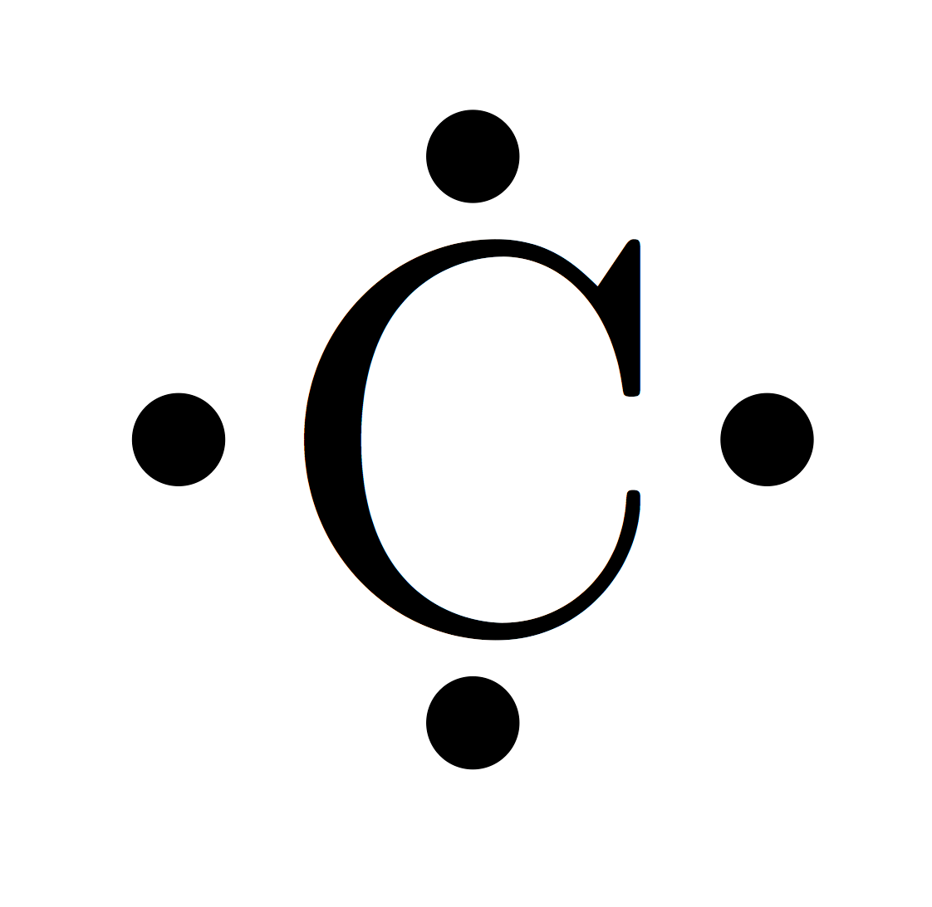
Carbon
http://molview.org/?cid=297
Carbon’s bonding capacity = 4
Can form 4 covalent bonds
There are 4 valence electrons
Sharing 1 valence electron forms a covalent bond

Slide 6
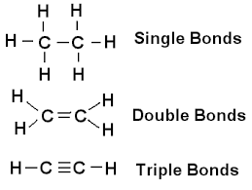
Carbon
Carbon can make double or triple covalent bonds

Slide 7
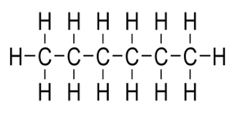
Saturated hydrocarbons
Saturated hydrocarbons are hydrocarbons that contain only single bonds between carbon atoms
Simplest class of hydrocarbons
Each carbon atom is bonded to as many hydrogen atoms as possible. i.e. the carbon atoms are saturated with hydrogen
This makes them relatively unreactive, apart from their interaction with oxygen in the air in the case of combustion

Slide 8
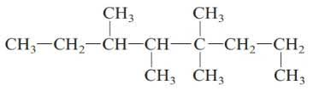
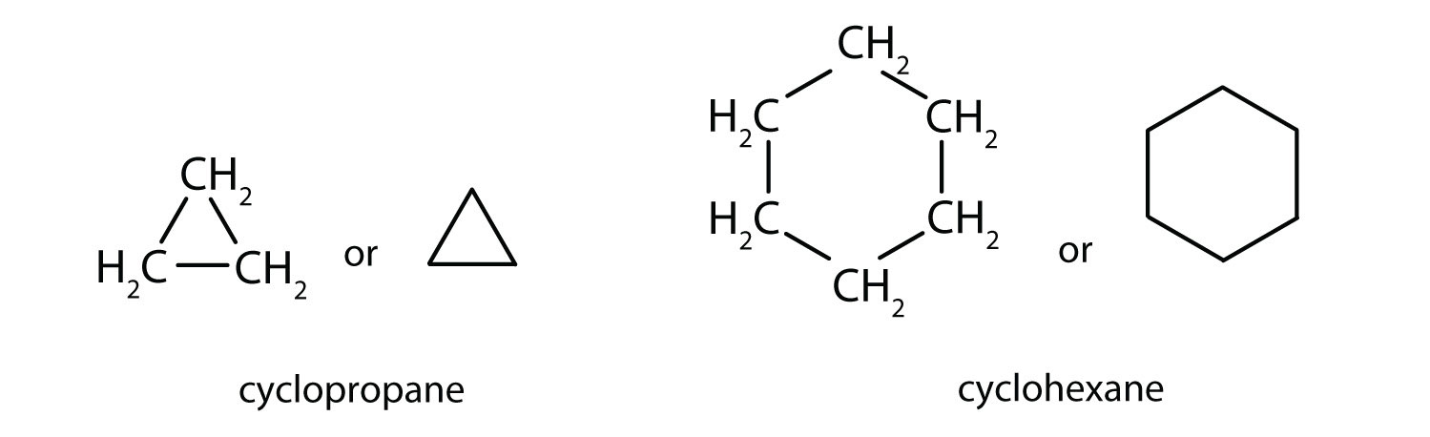
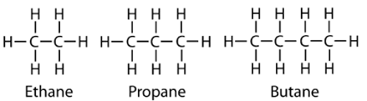
Alkanes
The alkanes are a family of hydrocarbons
Alkanes are saturated hydrocarbons with only single bonds between the carbon atoms
Some can be arranged in continuous straight chains or can be arranged in a branched chain or in a ring
Notes:
Taken from: https://www.ck12.org/book/cbse-chemistry-book-class-x/section/4.4/

Slide 9
Naming Alkanes – Straight chain
Alkanes with carbon atoms arranged in a continuous straight chain. Take note of the prefixes, Meth, Eth, Prop, But, Pent, Hex, Hept, Oct. Name ends in -ane
Alkane | Chemical Formula | Boiling Point(°C) | Melting Point(°C) | State (at 20 °C)
Methane | CH₄ | -162 | -183 | gas
Ethane | C₂H₆ | -89 | -172 | gas
Propane | C₃H₈ | -42 | -188 | gas
Butane | C₄H₁₀ | 0 | -138 | gas
Pentane | C₅H₁₂ | 36 | -130 | liquid
Hexane | C₆H₁₄ | 69 | -95 | liquid
Heptane | C₇H₁₆ | 98 | -91 | liquid
Octane | C₈H₁₈ | 126 | -57 | liquid

Slide 10
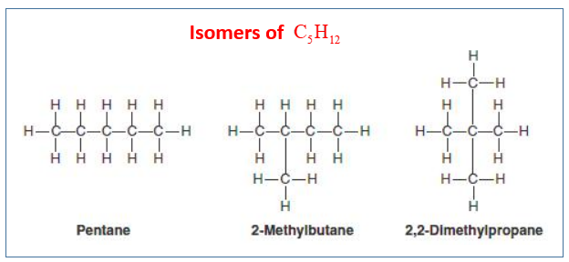
Structural Isomers
Isomers = organic molecules with the same molecular formula but a different structural formula
Structural isomers have
Different names
Different chemical properties
Different shapes

Slide 11
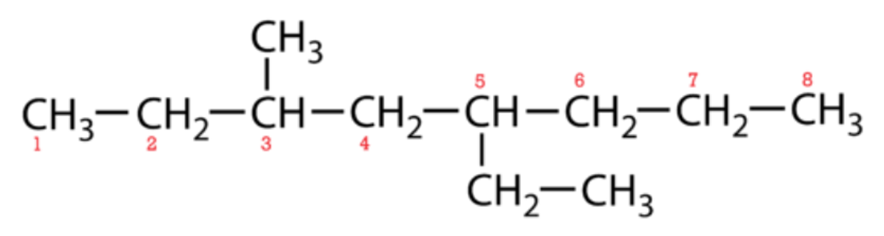
Naming Alkanes - branched
1. Find the parent chain = longest continuous chain of carbon atoms in the molecule In the example, the longest chain is = eight carbon atoms therefore octane
2. Number the carbon atoms in the parent chain. Start at the end that will give the smallest numbers possible to the carbon atoms where the branches originate. In the example, the branches are on carbons 3 and 5 when the chain is numbered left-to-right. If numbered right-to-left, the branches would be on carbons 4 and 6, therefore left-to-right is preferable.

Slide 12
Naming Alkanes - Branched
3. Substituents = atoms attached to the parent chain. Alkyl group = A substituent that is a hydrocarbon. The names of alkyl groups use the same prefixes as the alkanes, but with a –yl suffix.
1-carbon alkyl group = methyl group,
2-carbon alkyl group = ethyl group
3-carbon alkyl group = propyl , and so on.
The substituents are named by placing the carbon number from the parent carbon chain in front of the name of the substituent. In the current example, we have 3-methyl and 5-ethyl substituents.

Slide 13
Naming Alkanes - branched
4. Use a prefix to indicate the appearance of more than one of the same substituent in the structural formula. Two of the same group is di-, three is tri-, four is tetra-, etc. For example, if methyl groups were attached to both carbons 2 and 3, that part of the name would be 2, 3-dimethyl-. This rule does not apply to the example.
5. Multiple different substituents are listed in alphabetical order. Ignore any of the prefixes from rule 4. In the current example, the 5-ethyl- comes before the 3-methyl.

Slide 14
Naming Alkanes - branched
6. Commas are used to separate multiple numbers. Hyphens come between the number and the name of a substituent. The parent name comes immediately after the last substituent. There are no blank spaces in the name.
According to the IUPAC system the hydrocarbon below is 5-ethyl-3-methyloctane.

Slide 15
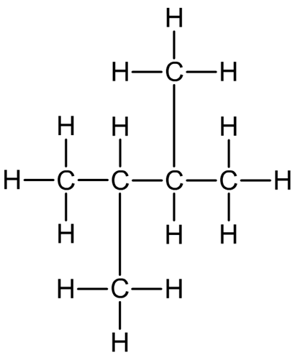
Example
Number the carbons in parent chain = 4
Butane
On carbon 2 and 3 there are methyl substituents
2,3-dimethyl
Put it all together
2,3-dimethylbutane

Slide 16
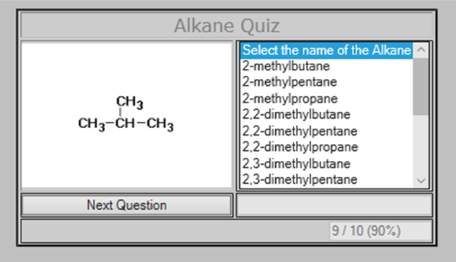
Your turn
Go to http://chemware.co.nz/orgquiz.htm

Slide 17
Molecular formula for alkanes
n = number of carbon atoms
H = 2n +2
E.g. if n = 4
Then H = 2 x 4 +2 = 10
Therefore C₄H₁₀

Slide 18
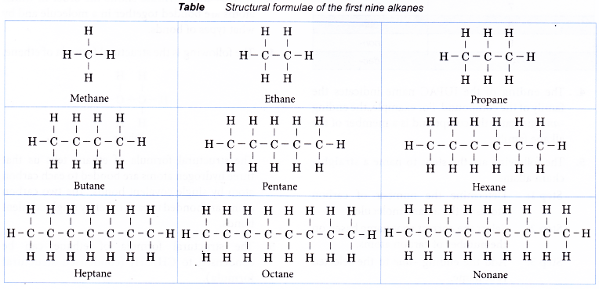
Structural formula alkanes
Must include all hydrogen atoms in your drawing!

Slide 19
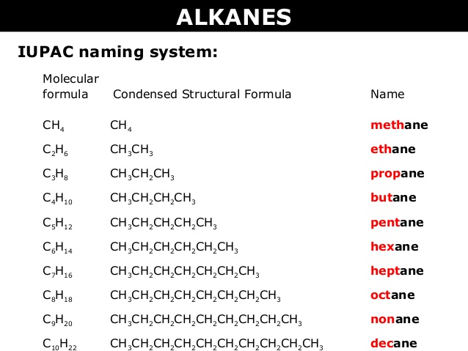
Condensed structural formula Alkanes

Slide 20
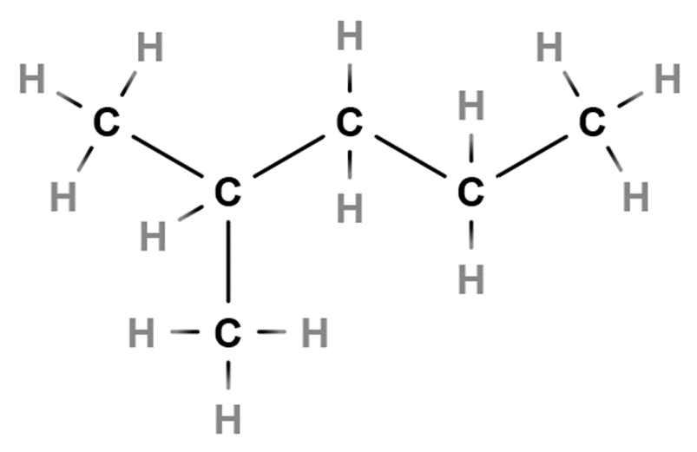
Condensed structural formula – alkanes (branched)
2-methylpentane
Draw the structural formula
Write the condensed structural formula
CH₃CH(CH₃)CH₂CH₂CH₃
Or CH₃CH(CH₃)(CH₂)₂CH₃
Write your own rules for writing condensed structural formula for branched alkanes

Slide 21
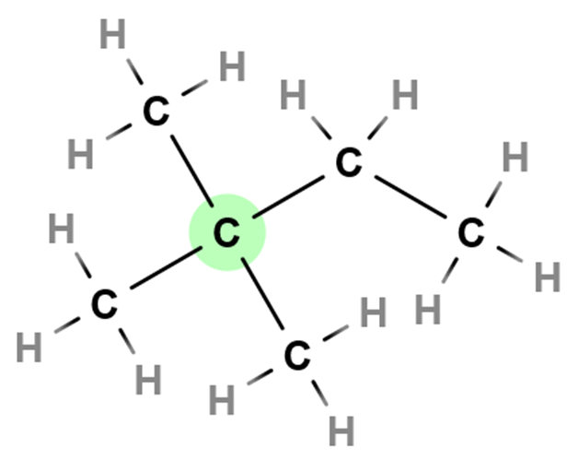
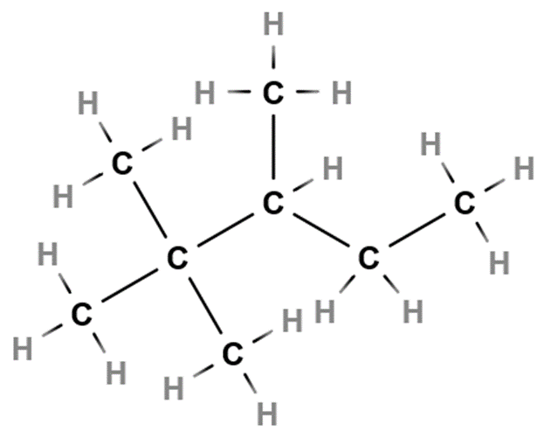
Your turn
Draw the structural formula and condensed structural formula for
2,3-dimethylbutane
2,2,3-trimethylpentane
C
CH₃CH(CH₃)CH(CH₃)CH₃ CH₃C(CH₃)₂CH(CH₃)CH₂CH₃

Slide 22
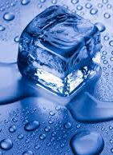
Terminology
Melting point
The melting point of a substance is the temperature at which matter changes from solid to liquid form

Slide 23
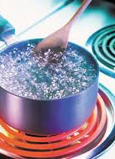
terminology
Boiling point
The temperature at which a compound changes state from liquid to gas

Slide 24
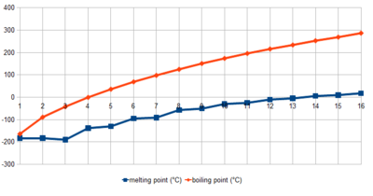
Melting and boiling points - alkanes
Alkanes have low melting or boiling points
Due to very weak intermolecular forces between alkane molecules.
Methane, ethane, propane, and butane are gases at room temperature.
As the carbon chain gets longer, because the attraction between the molecules increases, therefore more energy is needed to overcome these forces of attraction (van der Waals’ forces – explained in notes section)
Notes:
Van der Waals’ Forces
Van der Waals’ forces are named after the Dutch scientist J D Van der Waal who discovered them. The forces are created by the constant movement of electrons in atoms of molecules at high speeds. At any instant in time there is the likelihood that one side of the molecule has a greater proportion of electrons. When this happens a temporary imbalance of the electrons result in the molecule producing a negative and positive end. An atom or molecule that has an imbalance in charge is called a dipole and a temporary imbalance in charge produces a temporary dipole. The temporary imbalance in charge or temporary dipole can attract the electron cloud from a neighbouring atom or molecule i.e. the slightly positive end of the temporary dipole will attract the electrons from a neighbouring molecule. This means the temporary dipole induces an imbalance of the electrons in the neighbouring molecule.
The strength of the Van de Waals’ force is dependent on the size of the atoms or molecules. As the size and molecular mass of the molecule increases so does the number of electrons resulting in a greater imbalance in charge and hence a stronger Van der Waals’ attraction. This is the reason why the boiling points increase as the number of carbon atoms increase in alkanes, more energy is required to overcome the stronger Van der Waals’ forces of attraction.

Slide 25
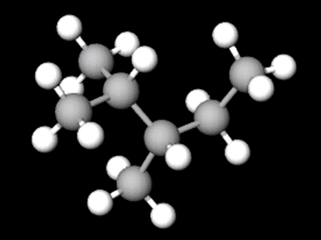
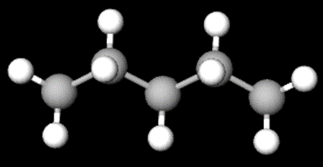
Melting and boiling points branched isomers of Alkanes
Branched isomers have lower boiling /melting points, because the branches prevent the molecules getting close so they cannot attract each other so strongly.
Versus

Slide 26
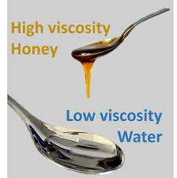
terminology
Viscosity
Viscosity refers to the thickness of fluid.
Viscosity, the "thickness" of fluid, refers to how resistant a fluid is to movement through it.
Water has a low or "thin" viscosity, for example, while honey has a "thick" or high viscosity.

Slide 27
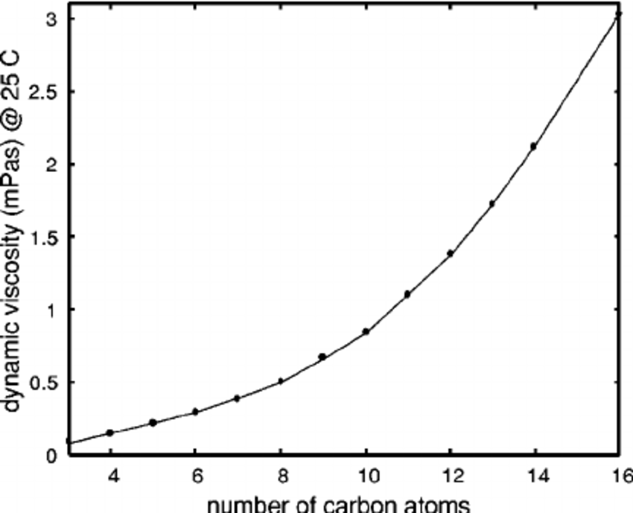
Viscosity of Alkanes
Methane, ethane, pentane and butane = gases at room temperature.
The alkanes from pentane through to C₁₆ are liquids
The viscosity of liquid alkanes increases as the number of carbon atoms increase
The increase in viscosity is due to the increase in intermolecular forces between molecules of increasing size

Slide 28
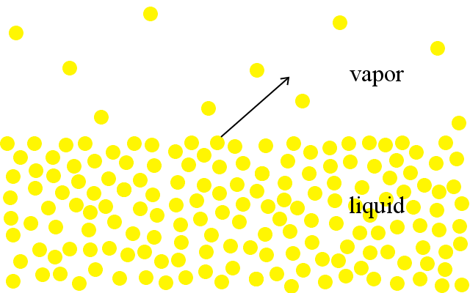
terminology
Volatility
Volatility is a measure of how readily a substance vaporizes or transitions from a liquid phase to a gas phase

Slide 29
Volatility alkanes
High volatility = Low boiling point.
High volatility = Weak intermolecular forces, thus fewer number of carbons in straight chain the higher the volatility

Slide 30
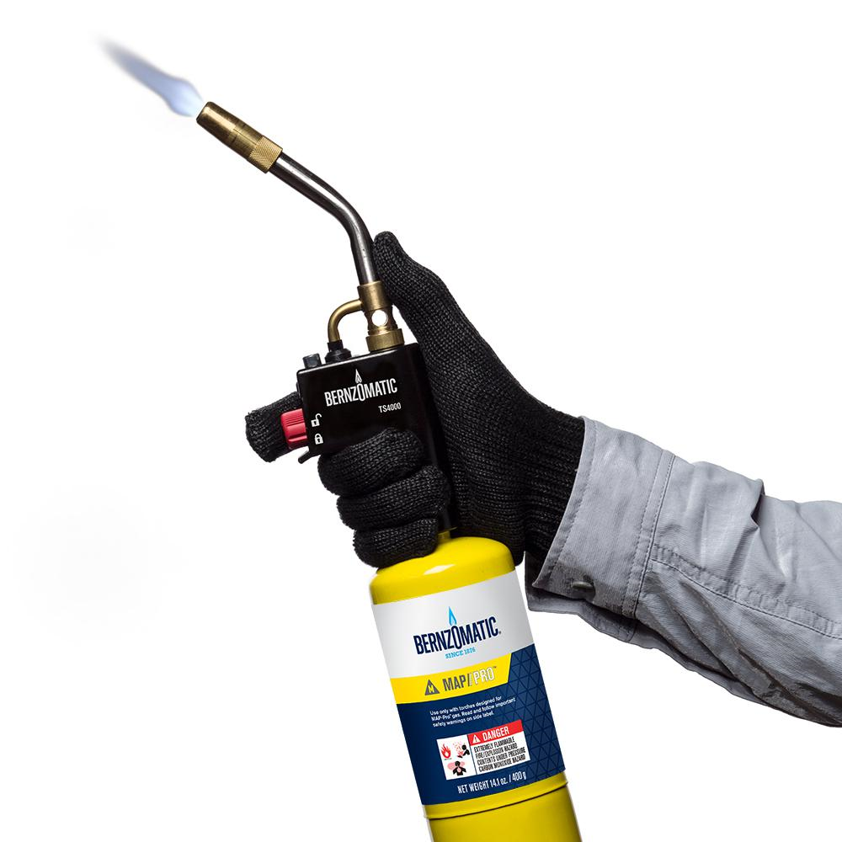
Chemical properties of Alkanes
Combustion
Alkanes are flammable and catch fire easily
Complete combustion (lots of Oxygen present) produces CO₂ and H₂O
Incomplete combustion (limited oxygen) produces CO and H₂O

Slide 31
Practice questions Alkanes
1) Name the straight-chain alkanes containing two, four, six, and eight carbons respectively and draw diagrams showing all the bonds in these compounds
2) Write an equation for complete combustion of butane
3) Draw structural formulas for the following hydrocarbons
Methylbutane
2,2-dimethylpentane
2,3-dimethylpentane
2,2,4-trimethylpentane
3,-ethylhexane
Tetramethylbutane (why are no numbers required?)

Slide 32
Practice questions Alkanes cont.
4) Name the following compounds
(CH₃)₂CHCH(CH₃)₂
CH₃CH₂C(CH₃)₂CH(CH₂CH₃)CH₂CH₂CH₃
5) There are 9 structural isomers with the molecular formula C₇H₁₆
Draw structures for three isomers which are chain structural isomers
Draw structures for three isomers which are position structural isomers

Slide 33
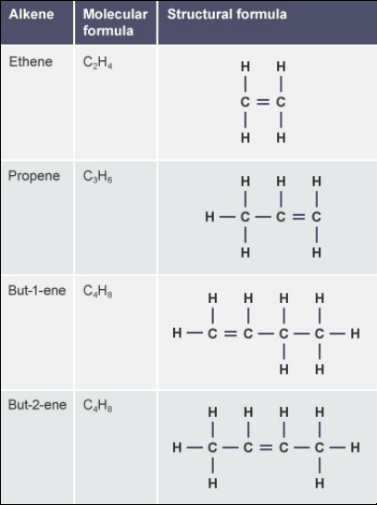
Alkenes
Alkenes make up a family of hydrocarbons that each contain one double bond between two carbon atoms
Unsaturated hydrocarbons
C=C double bond
The double bond is the functional group of the Alkene homologous series

Slide 34
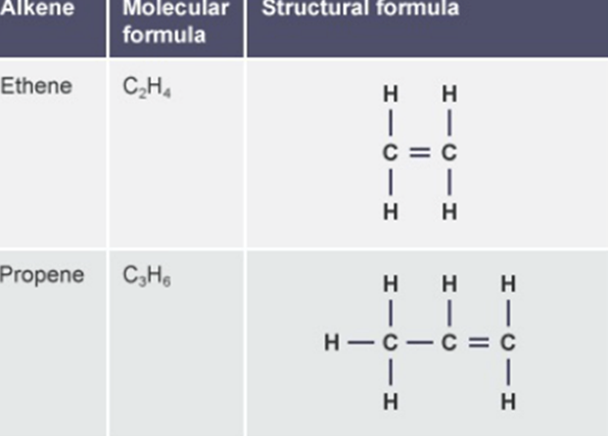
Naming Alkenes – Straight chain
Alkenes with carbon atoms arranged in a continuous straight chain.
Retain the prefixes, Eth, Prop, But, Pent, Hex, Hept, Oct for the parent compound
Parent compound is the longest chain containing the C=C
Number the chain from the end that gives the C=C the lowest number
Family name suffix = ene

Slide 35
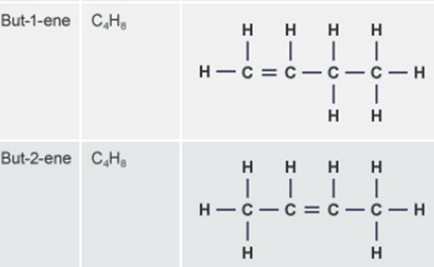
Naming Alkenes – structural isomerism
Alkenes containing 4+ carbons in the hydrocarbon chain structural isomerism occurs
E.g. C₄ alkene C₄H₈ has two isomers (see image)
Use the lower number of the C where the double bond occurs for suffix n-ene (see image)
The prefix is still the same as for alkanes; but, pent, hex, hept, oct.

Slide 36
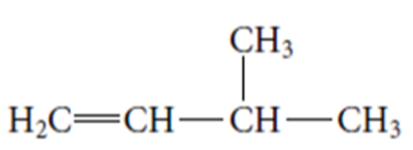
Naming Alkenes - branched
1. Find the parent chain = longest continuous chain of carbon atoms in the molecule with the C=C, this is given the stem name e.g. 6 carbons = hex, suffix = n-ene
2. Number the carbon atoms in the parent chain that will give the C=C the lowest number.
In the example but-1-ene

Slide 37
Naming alkenes - Branched
3. Name the side chains in the same way as with Alkanes
In the example 3-methylbut-1-ene

Slide 38
Molecular formula for alkenes
C_{n}H_{2n}
n = number of carbon atoms
H = 2n
E.g. if n = 4
Then H = 2 x 4 = 8
Therefore C₄H₈

Slide 39
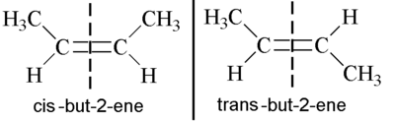
geometrical structural isomers
There is no rotation possible around a double bond
Two molecules can form where the position of the double bond remains the same but the spatial arrangement across the double bond is different
cis isomer – CH₃ groups are on the same side of the double bond
trans isomer – CH3 groups are on opposite sides of the double bond
Use https://molview.org/, type is cis-but-2-ene and trans-but-2-ene and compare the 3D structures

Slide 40
properties of Alkenes
Alkenes are more reactive than alkanes due to the relatively instability of the double bond
Breaking a carbon-carbon bond from a double bond between carbon atoms requires less energy than breaking a single C-C bond
The boiling and melting points of alkenes are generally slightly lower than alkanes with the same number of carbon atoms. The boiling temperature propene = -48°C, propane = -42°C
The boiling point of straight-chain alkenes is more than branched-chain alkenes just as in alkanes.
Alkenes with 2-4 carbon atoms = gases at room temperature
Alkenes with 5-17 carbon atoms = liquids at room temperate

Slide 41
Properties of Alkenes
Viscosity of alkenes increases with increased carbon chain length
Volatility of alkenes decreases with increased carbon chain length

Slide 42
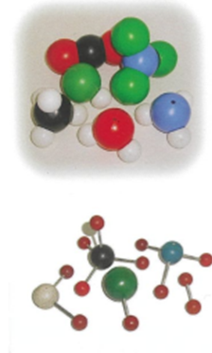
Molymod practical
Work through the instructions on handout
Upload a photo of your drawings to Connect submissions

Slide 43
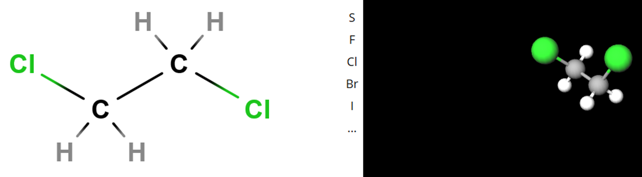
Interactive
http://molview.org/

Slide 44
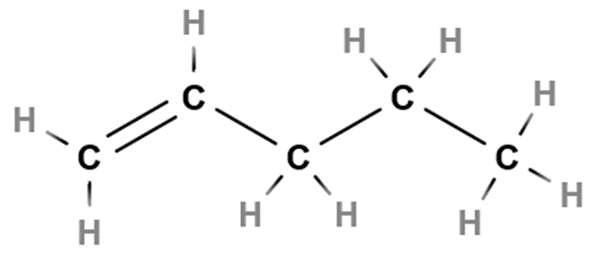
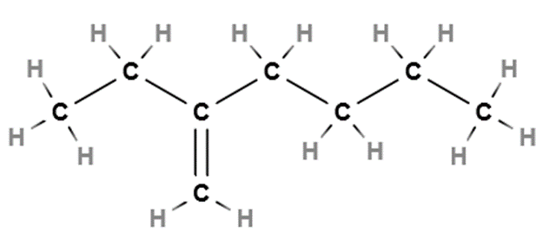
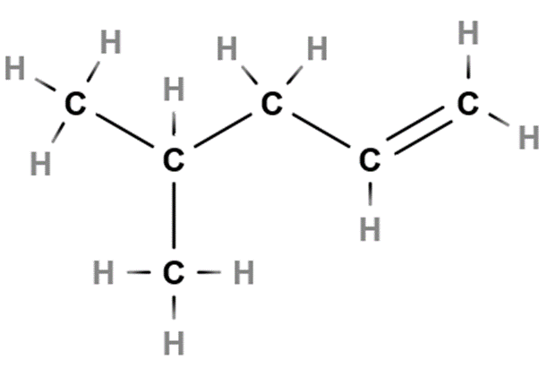
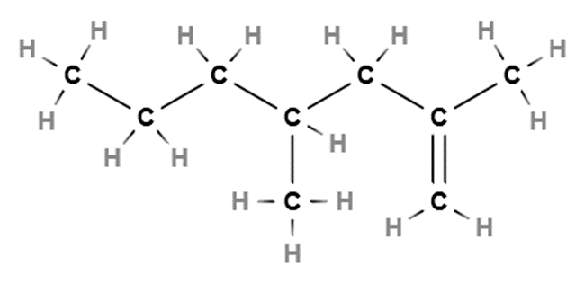
Practice questions - AlkEnes
1) Name the following structures
a) b)
c) d)
2
4
3
5
6
1

Slide 45
Practice – Alkenes cont.
2) Draw the structures for the following Alkenes
5,5-dimethylhept-3-ene
Oct-4-ene
3,4-diethylhex-2-ene
Hex-2-ene

Slide 46
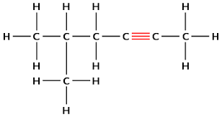
Alkynes
Alkynes make up a family of hydrocarbons that each contain one triple bond between two carbon atoms
Unsaturated hydrocarbons
C C triple bond
The triple bond is the functional group of the Alkyne homologous series
The molecular formula for alkynes = C_{n}H_{2n−2}

Slide 47
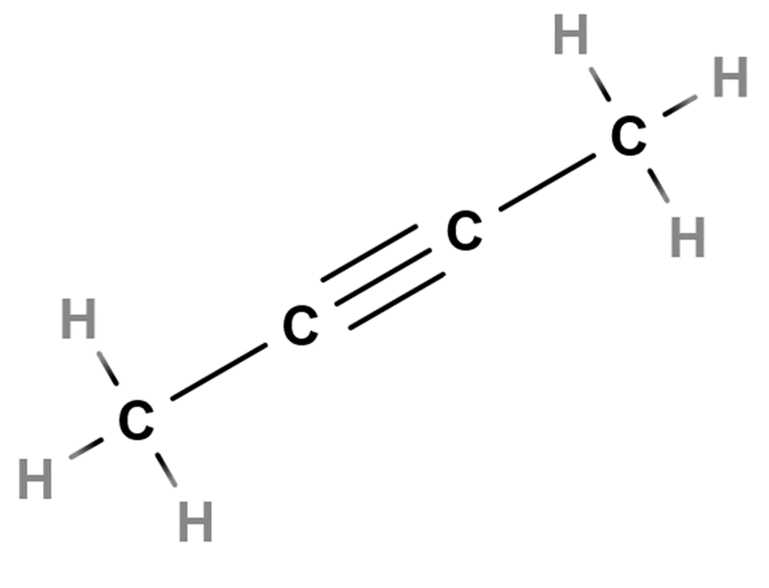
Naming Alkynes – Straight chain
Alkenes with carbon atoms arranged in a continuous straight chain.
Retain the prefixes, Eth, Prop, But, Pent, Hex, Hept, Oct for the parent compound
Parent compound is the longest chain containing the C C
Number the chain from the end that gives the C C the lowest number
Family name suffix = yne
But-2-yne

Slide 48
Properties of Alkynes
Ethyne, propyne and butyne = gases, C₅-C₁₂ = liquid
Boiling Points
Compared to alkanes and alkenes, alkynes have a slightly higher boiling point. Ethane has a boiling point of -88.6°C, while Ethene is -103.7°C and Ethyne has a higher boiling point of -84.0°C.
Viscosity of alkynes increases with increased carbon chain length
Volatility of alkynes decreases with increased carbon chain length

Slide 49
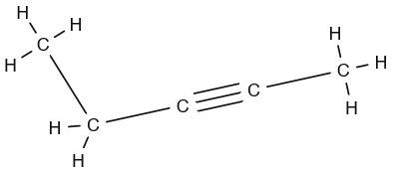
Practice questions - Alkynes
1) Oct-6-yne
a) Draw the molecular structure
b) Give the condensed molecular structure
c) Write the molecular formula
2)
Name the Alkyne
Give the condensed molecular structure
Write the molecular formula

Slide 50
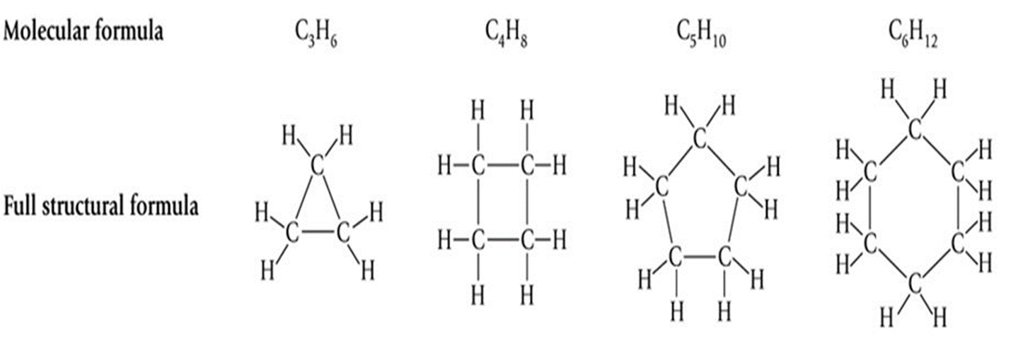
cycloalkanes
Rings of carbon atoms with distinguishing chemical properties = cycloalkanes
Cycloalkanes only contain carbon-hydrogen bonds and carbon-carbon single bonds, but in cycloalkanes, the carbon atoms are joined in a ring
The smallest cycloalkane is cyclopropane
Formula = C_{n}H_{2n}

Slide 51
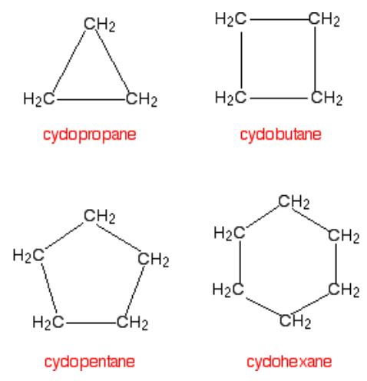
Naming cycloalkanes
Use the number of carbons in the ring to determine the prefix prop, but, pent, hex, hept, oct.
Suffix = ane
Place cyclo- in front
E.g. cyclopentane, cyclobutane

Slide 52
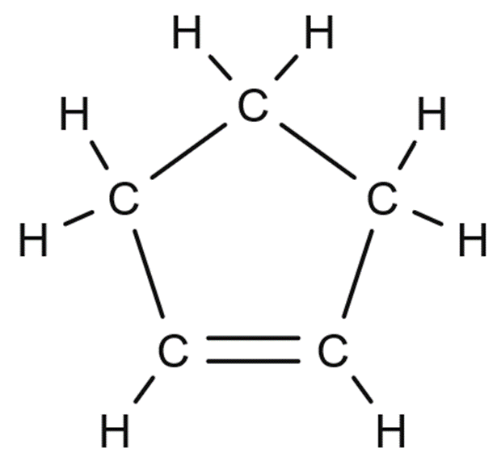
cycloalkenes
Cycloalkenes have the general formula C_{n}H2_{(n-m)}. The letter m represents the number of double bonds. Thus, cyclopropene has the formula C₃H₄ while that of cyclobutene is C₄H₆.

Slide 53
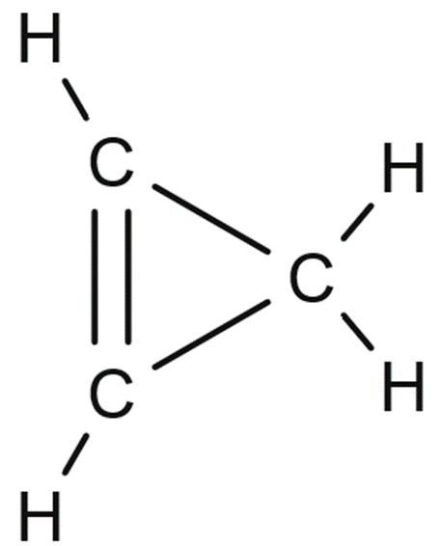
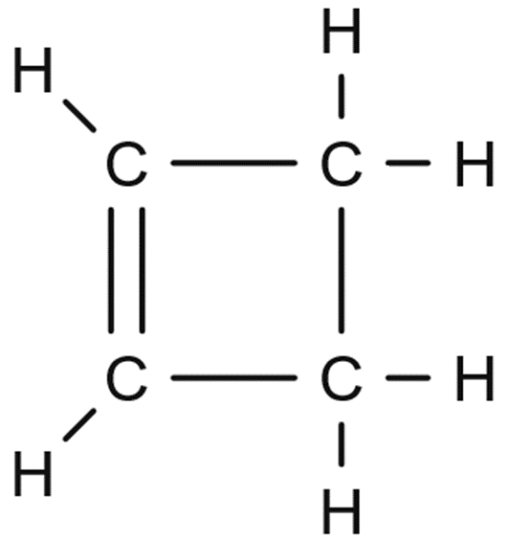
Naming cycloalkenes
Use the number of carbons in the ring to determine the prefix prop, but, pent, hex, hept, oct.
Suffix = ene
Place cyclo- in front
E.g. cyclopentene, cyclobutene

Slide 54
Practice questions cycloalkanes, cycloalkenes
Name, draw the molecular structure and provide the molecular formula for the cycloalkanes with 3-8 carbon atoms
Name, draw the molecular structure and provide the molecular formula for the cycloalkenes with 3-8 carbon atoms
Check your answers using molview

Slide 55
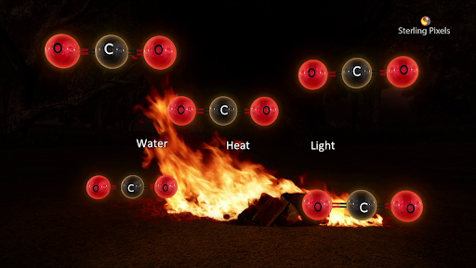
Predicting products of combustion reactions
Complete combustion - Lots of Oxygen present
Hydrocarbon + O_{2(g)} → CO_{2(g)} + H₂O_{(g)} + energy
Incomplete combustion - Limited amount of oxygen present
Still yields CO₂ and H₂O
But also makes toxic by-products CO and C
Notes:
C_{n}H_{2n+2} + ((3n+1)/2)O₂ → nCO₂ + (n+1)H₂O Alkanes

Slide 56
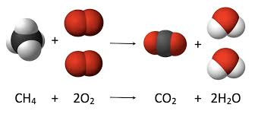
balancing equations Combustion
Step 1. Balance C
Step 2. Balance H
Step 3. Balance O, if it is an odd number multiple everything by 2

Slide 57
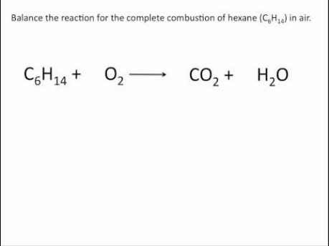

Slide 58
Answers – Practice questions Alkanes
1) Ethane (C2), Butane (C4), Hexane (C6), Octane (C8)
2) 2CH₃CH₂CH₂CH_{3(g)} + 13O_{2(g)} → 8CO_{2(g)} + H₂O_{(g)}
3) See next slide
4) 2,3–dimethylbutane
3,3-dimethyl-4-ethylheptane

Slide 59

Answers – Practice questions Alkanes
3)

Slide 60

Answers – Practice questions Alkanes
5)

Slide 61




Answers practice questions - Alkenes
1 a) pent-1-ene, b) 2-ethylhex-1-ene, c) 4-methylpent-1-ene, d) 2,4-dimethylhept-1-ene
2 a) b)
c) d)

Slide 62

Answers practice questions - Alkynes
a) b) CH₃C₂(CH₂)₄CH₃ c) C₈H₁₄
a) Pent-3-yne b) CH₃CH₂C₂CH₃ c) C₅H₈

